Slide 1






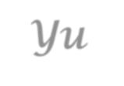
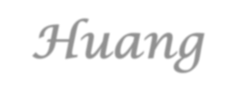

Introduction to
Algorithm Design and Analysis
[14] Minimum Spanning Tree
Yu Huang
http://cs.nju.edu.cn/yuhuang Institute of Computer Software Nanjing University

Slide 2
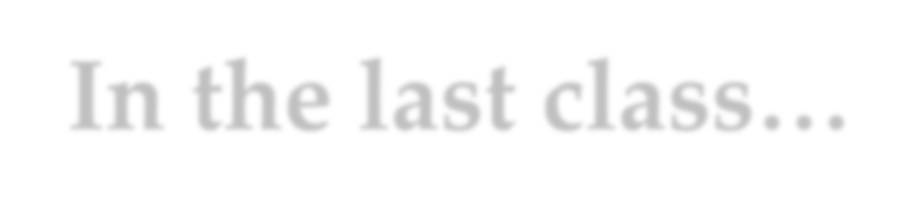
In the last class…
Undirected and Symmetric Digraph
DFS skeleton
Biconnected Components
Articulation Point
Bridge
Other undirected graph problems
Orientation for undirected graphs
MST based on graph traversal

Slide 3

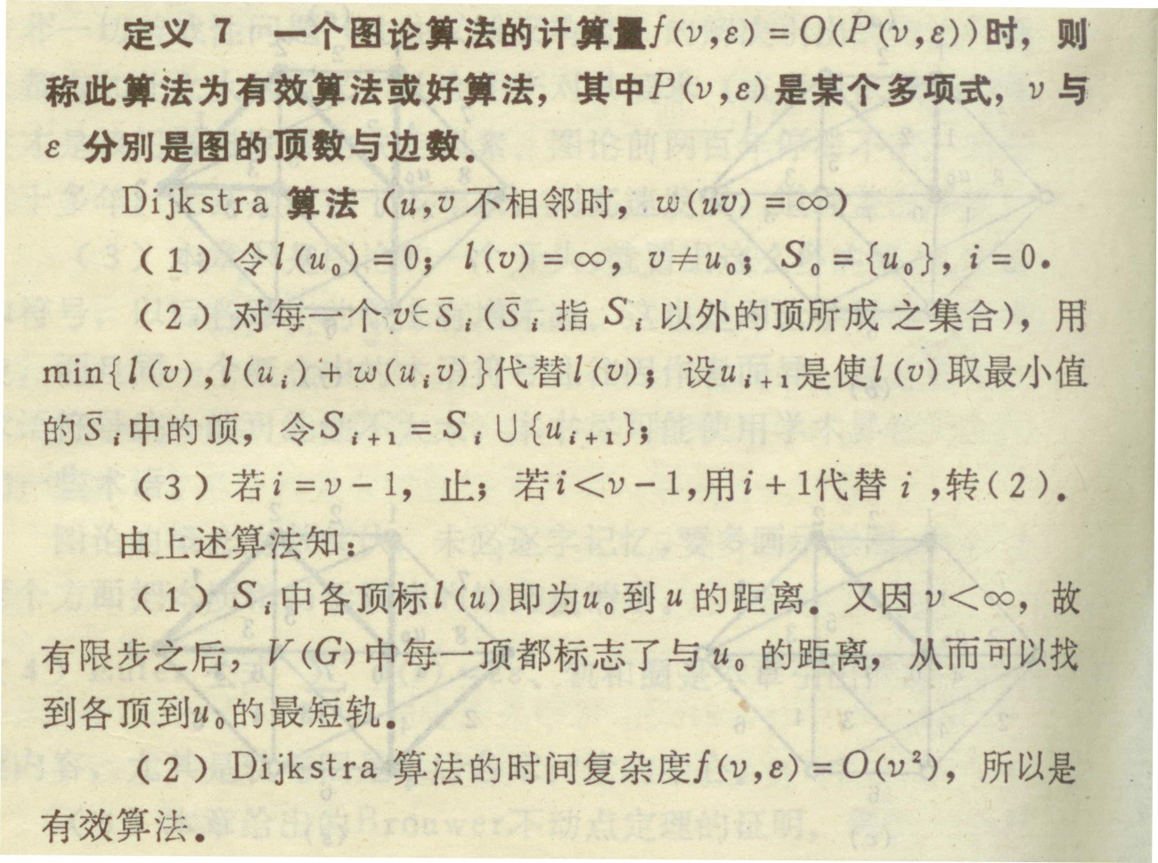



当年我们学贪心算法

Slide 4

Greedy Strategy
Optimization Problem
Greedy Strategy
MST Problem
Prim’s Algorithm
Kruskal’s Algorithm
Single-Source Shortest Path Problem
Dijkstra’s Algorithm

Slide 5


Greedy Strategy for Optimization Problems
Coin change Problem
[candidates] A finite set of coins, of 1, 5, 10 and 25 units, with enough number for each value
[constraints] Pay an exact amount by a selected set of coins
[optimization] a smallest possible number of coins in the selected set
Solution by greedy strategy
For each selection, choose the highest-valued coin as possible.

Slide 6

Greedy Fails Sometimes
We have to pay 15 in total
If the available types of coins are {1,5,12}
The greedy choice is {12,1,1,1}
But the smallest set of coins is {5,5,5}
If the available types of coins are {1,5,10,25}
The greedy choice is always correct

Slide 7
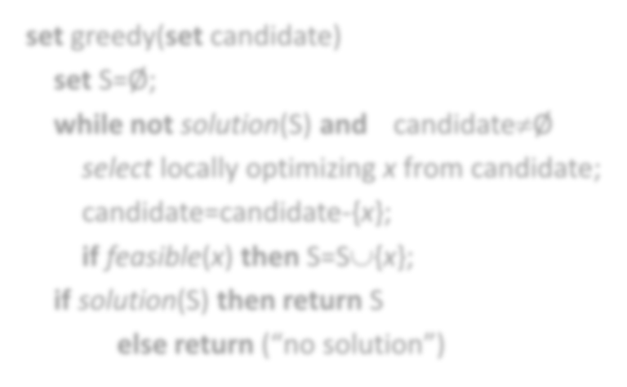

Greedy Strategy
Expanding the partial solution step by step.
In each step, a selection is made from a set of candidates. The choice made must be:
o [Feasible] it has to satisfy the problem’s constraints
[Locally optimal] it has to be the best local choice among all feasible choices on the step
[Irrevocable] the choice cannot be revoked in subsequent steps
set greedy(set candidate)
set S=Ø;
while not solution(S) and candidate≠Ø select locally optimizing x from candidate; candidate=candidate-{x};
if feasible(x) then S=S∪{x};
if solution(S) then return S
else return (“no solution”)

Slide 8



Weighted Graph and MST
B
A Spanning Tree: W(T)=257
27
26
A
34 25
18
21
C
42 E
36
D
B
33 29 22
16
I
21
28
21
J 25
27
26
H
F
21
A
34
C
42
E
17
36
D
G
B
53
25
18
33 29 22
16
I
21
28
21
J 25
A MST: W(T)=190
H
F
27
26
17
A
34 25
18
H
21
C
42 E
53
36
33
G
A weighted graph
The nearest neighbor of vertex I is H
The nearest neighbor of shaded subset of vertex is G
D
29 22
16
^{I} 21
21
J 25
F
28
17
53
G

Slide 9








Graph Traversal and MST
All other edges
There are cases that graph traversal tree cannot be minimum spanning tree, with the vertices explored in any order.
with weight 5
1
1
1
1
1
DFS tree
BFS tree
in any ordering of vertex

Slide 10

Greedy Algorithms for MST
Prim’s algorithm:
Difficult selecting: “best local optimization means no cycle and small weight under limitation.
Easy checking: doing nothing
Kruskal’s algorithm:
Easy selecting: smallest in primitive meaning
Difficult checking: no cycle

Slide 11

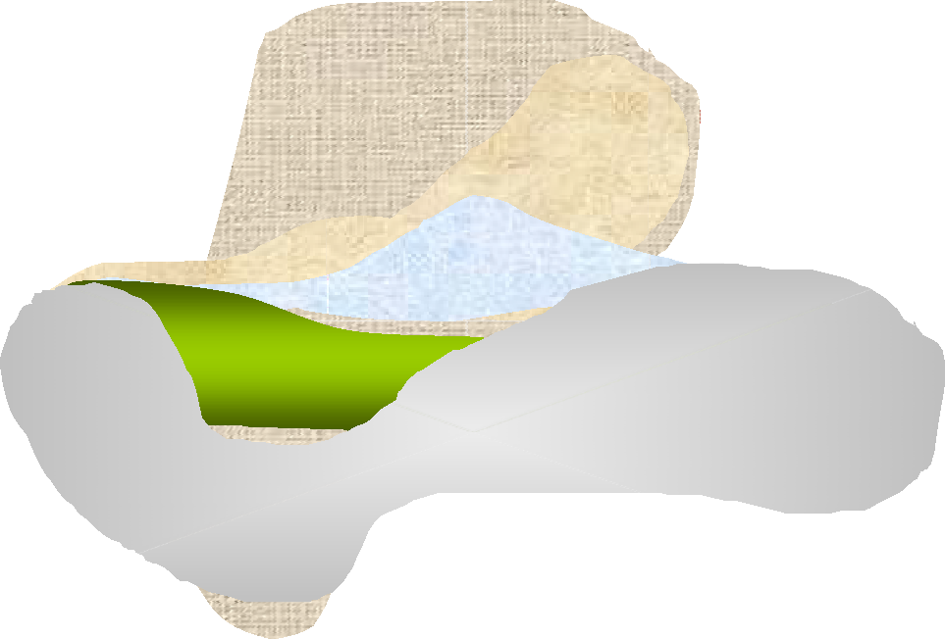



Prim’s Algorithm
_{A} 2 _{B}
3
6
3
7
4
Greedy strategy:
For each set of fringe vertex, select the edge with the minimal weight, that is, local optimal.
G
1
F
5 _{I}
H
8
C
4
2
6
2
2
E
1
D
edges included in the MST

Slide 12









Minimum Spanning Tree Property
A spanning tree T of a connected, weighted graph has MST property if and only if for any non-tree edge uv, T∪{uv} contain a cycle in which uv is one of the maximum-weight edge.
All the spanning trees having MST property have the same weight.
uv-path in T₁
u
u
edge exchange
Must have same weight
w
i
w_{i}
v
w
v
not in T₂
i+1
w
i+1
a new spanning tree: same weight as T₁, less different edges from that of T₂
edge uv in T₂ but not in T₁ , with minimum
weight among all different edges

Slide 13


MST Property and Minimum Spanning Tree
In a connected, weighted graph G=(V,E,W), a tree T is a minimum spanning tree if and only if T has the MST property.
Proof
⇒ For a minimum spanning tree T, if it doesn’t has MST property. So, there is a non-tree edge uv, and T∪{uv} contain an edge xy with weight larger than that of uv. Substituting uv for xy results a spanning tree with less weight than T. Contradiction.
⇐ As claimed above, any minimum spanning tree has the MST property. Since T has MST property, it has the same weight as any minimum spanning tree, i.e. T is a minimum spanning tree as well.

Slide 14


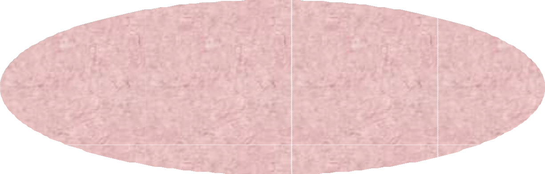






Correctness of Prim’s Algorithm
Let T_{k} be the tree constructed after the k^{th} step of Prim’s algorithm is executed. Then T_{k} has the MST property in G_{k}, the subgraph of G induced by vertices of T_{k}.
^{w}a+1
^{w}b-1
assumed first and last edges with larger weight than w(u_{i}v), resulting contradictions.
w_{a}
w_{b}
T
k-1
……
u (w )
u (w )
1 1
edge added in T_{k}
i p
Note: w(u_{i}v)≥w(u₁v), and if w_{a} added earlier than w_{b}, then w_{a}w_{a+1} and w_{b-1}w_{b} added later
added in T_{k} to form a cycle, only these need be considered
v, added in T
k
than any edges in u₁w_{a}-path,
and vLaecstuwreesloln Algorithm Design & Analysis (LADA), 2015
2015/5/15
16

Slide 15


Key Issue in Implementation
Maintaining the set of fringe vertices
Create the set and update it after each vertex is “selected” (deleting the vertex having been selected and inserting new fringe vertices)
Easy to decide the vertex with “highest priority”
Changing the priority of the vertices (decreasing key).
The choice: priority queue
Lectures on Algorithm Design & Analysis (LADA), 2015
2015/5/15
17

Slide 16

Implementation
ADT operation executions:
insert, getMin, deleteMin: n times decreaseKey: m times
Main Procedure
primMST(G,n)
Initialize the priority queue pq as empty; Select vertex s to start the tree;
Set its candidate edge to (-1,s,0); insert(pq,s,0);
while (pq is not empty)
v=getMin(pq); deleteMin(pq);
Updating the Queue
updateFringe(pq,G,v)
For all vertices w adjcent to v //2m loops
newWgt=w(v,w);
if w.status is unseen then
Set its candidate edge to (v,w,newWgt); insert(pq,w,newWgt)
add the candidate edge of v to the t
ree;
), 2015 18
updateFringe(pq,G,v);
return
else
if newWgt<getPriorty(pq,w)
Revise its candidate edge to (v,w,newWgt); decreaseKey(pq,w,newWgt)
getMin(pq) always be the vertex with the smallest key in the fringe set.
Lectures on Algorithm Design & Analysis (LADA
return
2015/5/15

Slide 17


Prim’s Algorithm
_{A} 2 _{B}
3 ×6
7×
5
4
Greedy strategy:
For each set of fringe vertex, select the edge with the minimal weight, that is, local optimal.
G
3
1
×₄
F
I
H
8
C
2
6
2
2
E
1
D
edges included in the MST

Slide 18

Complexity
Operations on ADT priority queue: (for a graph with n
vertices and m edges)
o insert: n ; getMin: n ; deleteMin: n ;
o decreasKey: m (appears in 2m loops, but execute at most m)
So,
T(n,m) = O(nT(getMin)+nT(deleteMin+insert)+mT(decreaseKey))
Implementing priority queue using array, we can get
Θ(n²+m)

Slide 19





Kruskal’s Algorithm
A
2
B
Also Greedy strategy:
From the set of edges not yet included in the partially built MST, select the edge with the minimal weight, that is, local optimal, in another sense.
3
6
3
7
G
4
1
F
5
I
H
8
C
4
2
6
2
2
E
1
D
edges included in the MST

Slide 20
Key Issue in Implementation
How to know an insertion of edge will result in a cycle efficiently?
For correctness: the two endpoints of the selected edge can not be in the same connected components.
For the efficiency: connected components are implemented as dynamic equivalence classes using union-find.

Slide 21

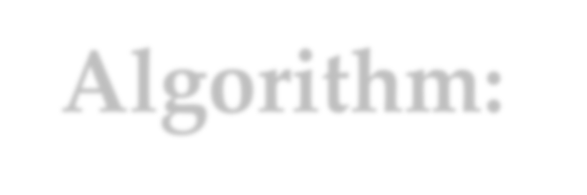



Kruskal’s Algorithm: the Procedure
kruskalMST(G,n,F) //outline
int count;
Build a minimizing priority queue, pq, of edges of G, prioritized by weight.
Initialize a Union-Find structure, sets, in which each vertex of G is in its own set.
•
F=φ;
while (isEmpty(pq) == false)
vwEdge = getMin(pq);
deleteMin(pq);
int vSet = find(sets, vwEdge.from);
int wSet = find(sets, vwEdge.to);
if (vSet ≠ wSet)
Add vwEdge to F;
union(sets, vSet, wSet)
return
Simply sorting, the cost will be Θ(mlogm)

Slide 22


Prim vs. Kruskal
Lower bound for MST
For a correct MST, each edge in the graph should be examined at least once.
So, the lower bound is Ω(m)
Θ(n²+m) and Θ(mlogm), which is better?
Generally speaking, depends on the density of edge of the graph.

Slide 23
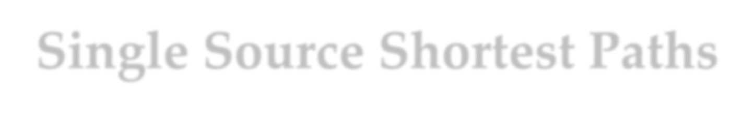









Single Source Shortest Paths
The single source
Red labels on each vertex is the length of the shortest path from s to the vertex.
Note:
The shortest [0, 3]-path doesn’t contain the shortest edge leaving s, the edge [0,1]
1 2
2
7
5
3
1
1 2
8
7
6
3
6
s ₀
2 4
3
4
3
4
6
4
5
9

Slide 24

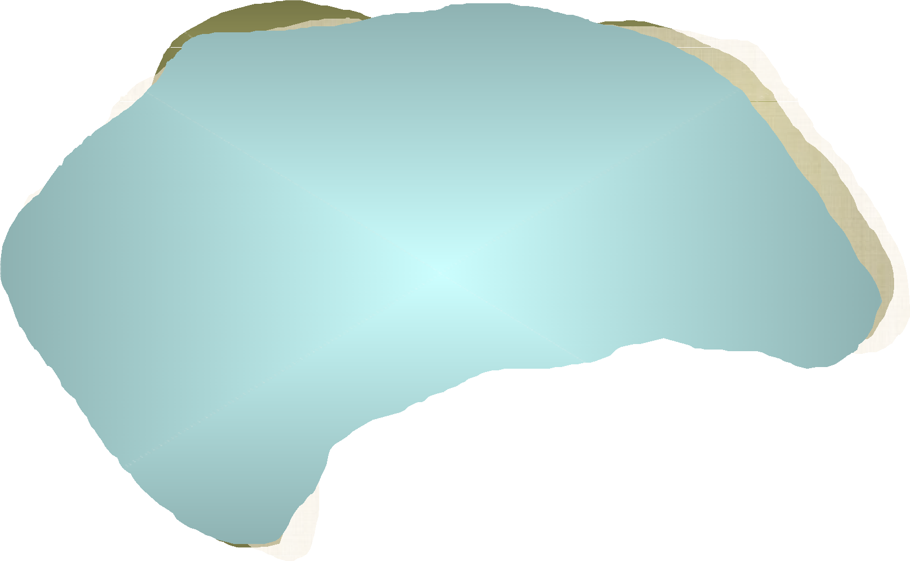
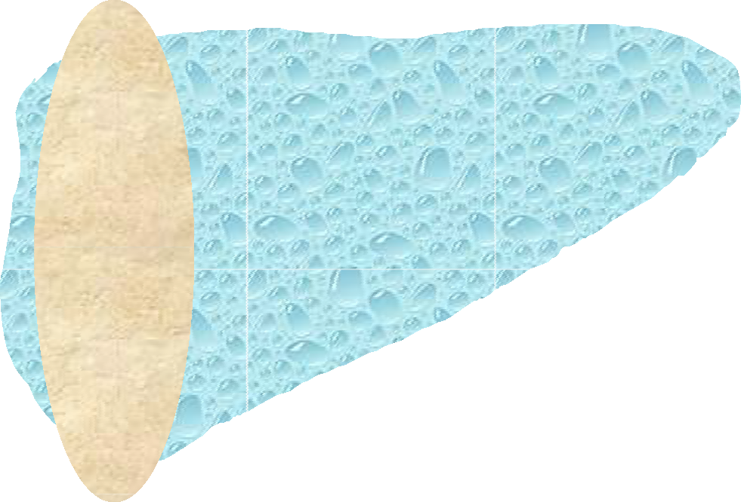
Dijkstra’s Algorithm
1∞ 2
∞₂
7
1
3
5
1
2
∞₆8
8
s
0
7
3
4∞3
∞76
4
3
4
2
4
6
∞4
5
∞9

Slide 25


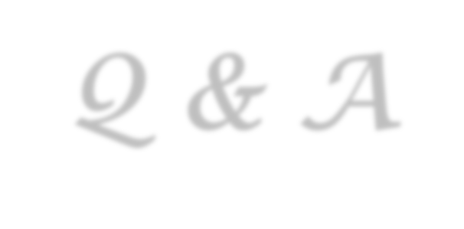

Thank you!
Q & A
Yu Huang
http://cs.nju.edu.cn/yuhuang

